Slide 1
LIPINSKI RULE OF 5
(In Python Prgramming Language)

Slide 2
Done by
M Maithri - IV Bioinfo
Anandhi S - IV Bioeng
Vaishnave S - IV Bioeng

Slide 3
OBJECTIVE
To verify if a drug molecule satsfies the Lipinski's rule of 5 using pubchempy module.

Slide 4
Drug molecules:-
A chemical substance that gives rise to a biological response.
Specific to a binding site, to avoid binding with other targets not of our choice
Binds to either the binding site or the allosteric sites
Has very good affinity to target

Slide 5
Development of drug
Hit molecule -> Lead
Lead -> Optimisation
Clinical testing
FDA approval -> DRUG

Slide 6
Lipinski's rule:-
Also known as Pfizer's rule
Rule of thumb to evaluate druglikeness
Formulated in 1997 based on empirical methods (i.e) by observation of existing drug molecules
Does not predict pharmocological activity

Slide 7
Rule of 5:-
Molecular weight < 500 Da
HBA <= 10
HBD <= 5
LogP <= 5

Slide 8
Partition Coefficient (Log P):-
Indirect measure of solubility
Ratio of concentration in a mixture of a hydrophilic and a hydrophobic solvent
Generally, the hydrophobic solvent is 1-octanol
Higher LogP => Higher Lipophilicity

Slide 9
PubChemPy:-
Allows interaction of Python with PubChem
PubChem is the repository of chemical molecules and their activities
Allows chemical searches by name, substructure and similarity, chemical standardization, conversion between chemical file formats, depiction and retrieval of chemical properties.

Slide 10
Pseudo Code:-
Give the name of the compound.
It will give a list of pubchem IDs that matches the compound.
Choose one and give it as an input.
Using Pubchempy functions calculate the molecular weight,number of hydrogen bond acceptors,number of hydrogen bond donors,log P value.
A counter is initialized till 4 and if the compound satisfies all four criteria, it is accepted if not it is eliminated.

Slide 11
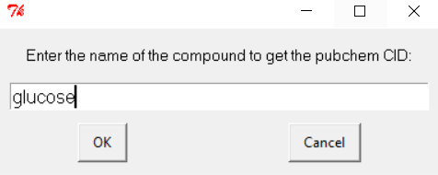
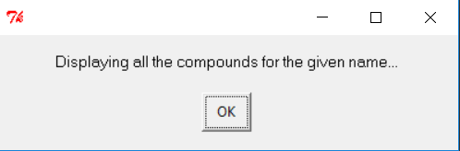
GUI
EasyGUI is the GUI used here.
1.
2.

Slide 12
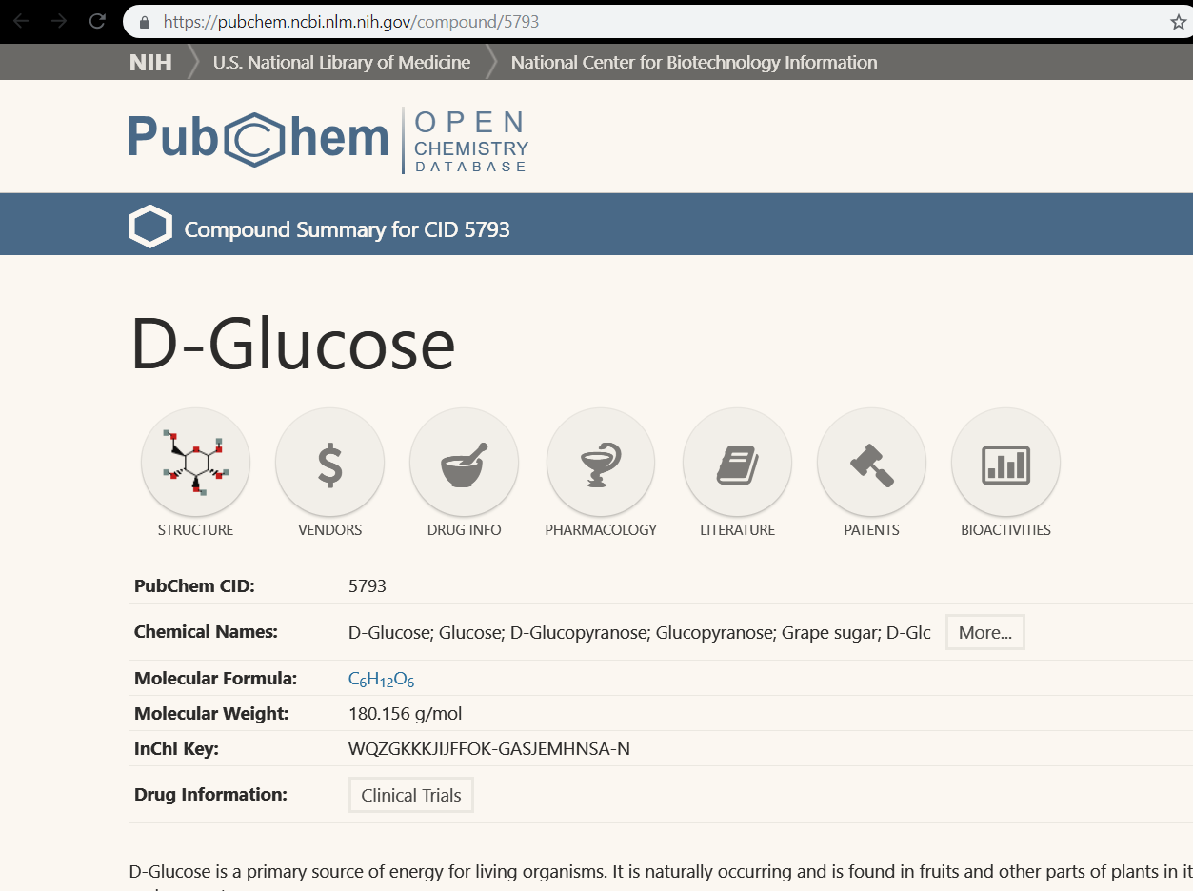
3.

Slide 13
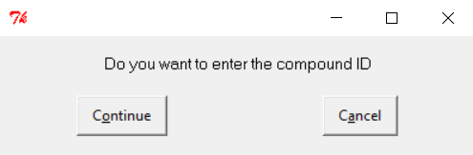
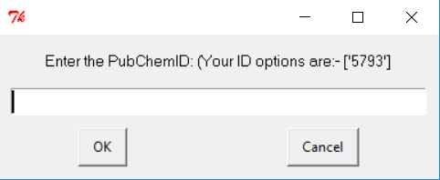
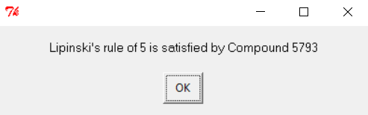
4.
5.
6.

